Slide 1



Predicting Airbnb Listing Prices Using Regression and Regularization Techniques
A comprehensive analysis of predictive modeling techniques applied to Airbnb pricing data
Notes:
1

Slide 2

Project Overview
Objective
Key Goals
This project develops predictive models to estimate Airbnb listing prices using statistical and machine learning techniques. The analysis focuses on building regression models that can accurately predict prices based on property characteristics, location data, and socio-economic indicators.
  Build predictive models for Airbnb prices
  Analyze impact of various factors on pricing
  Compare regression and regularization techniques
  Identify best performing model
As a prognostic model, this approach predicts future or unseen observations, making it valuable for both hosts setting competitive prices and customers evaluating fair market rates.
Model Type
Bias-Variance Tradeoff
Validation
Regression problem with continuous response variable
Balance between simple models (high bias, low variance) and complex models (low bias, high variance)
Training set (70%) and testing set (30%) with stratified sampling
Notes:
2

Slide 3

Data Description
The dataset consists of 51,707 Airbnb listings with multiple features related to property characteristics, location, and socio-economic indicators. The response variable is log-transformed listing price, while predictors include both quantitative and categorical variables.
Property Characteristics
Maximum guests, number of bedrooms, cleanliness score, guest satisfaction score, room type classification
Location Features
Distance to city center and metro, attraction and restaurant indices, longitude and latitude coordinates
Geographic Data
City, district, state, country codes and names for multi-level geographic classification
Economic Indicators
Crime and safety indices, monthly rent, utilities, average net salary, meal costs, taxi rates
Notes:
3

Slide 4
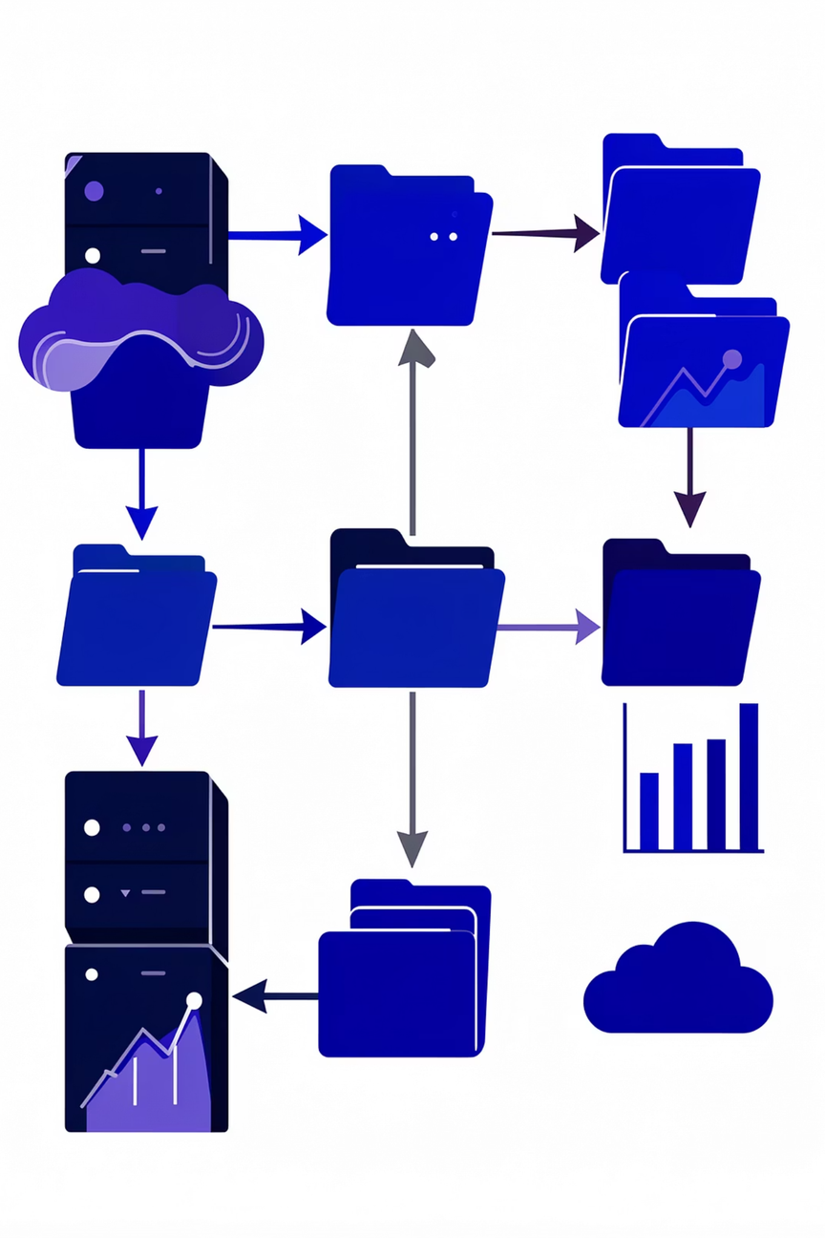
Data Preprocessing Steps
Missing Value Removal
All missing values were removed from the dataset to ensure data quality and model reliability
Log Transformation
Response variable (price) was log-transformed to normalize distribution and stabilize variance
Factor Conversion
Character variables converted to factors for proper handling of categorical predictors
Data Splitting
Dataset divided into training (70%) and testing (30%) sets using stratified sampling
The log transformation addressed strong right-skewness in the price distribution, improving model performance and interpretability. Factor conversion enabled the regression model to generate dummy variables and incorporate qualitative features effectively.
Notes:
4

Slide 5
Methodology Overview
Regression Techniques
Model Validation
  Multiple Linear Regression
  Stepwise Regression with AIC
  Ridge Regression
  LASSO
  Elastic Net
  K-Nearest Neighbors
  Generalized Linear Model
Diagnostic checks included residual analysis, outlier detection, and multicollinearity assessment using Variance Inflation Factor (VIF).
Model Diagnostics
Multicollinearity Handling
Residual analysis, outlier detection, and multicollinearity assessment using VIF
Removed redundant binary variables, normalized duplicates, and hierarchical categorical variables
Model Selection
Regularization
Stepwise regression using AIC, BIC, and Adjusted R-squared for comparison
Ridge, LASSO, and Elastic Net to reduce overfitting and handle multicollinearity
Notes:
5

Slide 6

Linear Regression Results
0.298
RMSE
Root Mean Square Error on test set
0.224
MAE
Mean Absolute Error on test set
0.837
R-squared
Proportion of variance explained
3569
F-statistic
Model significance test
The multiple linear regression model achieved strong performance with an R-squared of 0.837, indicating that 83.7% of price variation is explained by the predictors. The model showed statistical significance with F-statistic of 3569 (p-value < 2.2e-16).
Key Predictor Insights
  Room type significantly affects price (entire homes > private rooms > shared rooms)
  Number of bedrooms has positive effect on price
  Cleanliness and guest satisfaction scores positively influence pricing
  Distance from city center negatively affects price
  Economic indicators (rent, income levels) impact listing prices
Notes:
6

Slide 7

Regularization Techniques Performance
Regularization methods were applied to improve model performance, reduce overfitting, and handle multicollinearity. These techniques help in selecting important variables while maintaining predictive accuracy.
Ridge Regression
LASSO
RMSE: 0.356
RMSE: 0.355
Uses L2 regularization to shrink coefficients without eliminating variables
Uses L1 regularization to shrink coefficients and perform variable selection
Elastic Net
RMSE: 0.355
Combines L1 and L2 penalties for balanced variable selection and coefficient shrinkage
All three regularization methods performed similarly, with LASSO and Elastic Net achieving slightly better RMSE than Ridge regression. These techniques successfully reduced overfitting and handled multicollinearity in the dataset.
Notes:
7

Slide 8
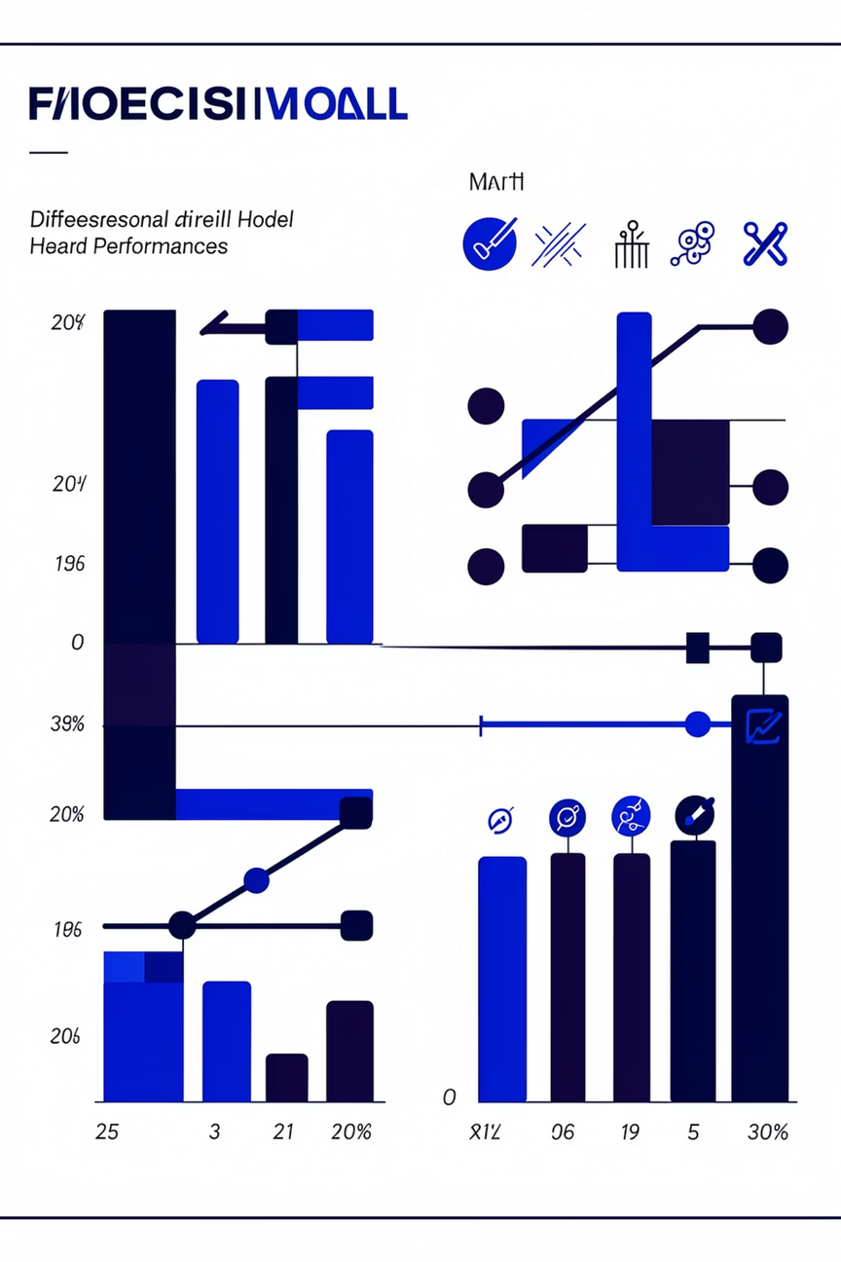




Model Comparison Results
Different models were compared based on RMSE performance metrics. Lower RMSE values indicate better predictive accuracy.
Linear Regression
RMSE: 0.298
Best performing model
Stepwise Regression
RMSE: 0.315
Improved model selection
KNN Regression
RMSE: 0.337
Non-parametric approach
Regularization
RMSE: 0.355-0.356
Reduced overfitting
Linear regression achieved the lowest RMSE of 0.298, making it the best performing model. Stepwise regression with AIC improved upon the initial model by selecting relevant predictors. KNN regression provided a non-parametric alternative with moderate performance. Regularization methods showed slightly higher RMSE but offered benefits in handling multicollinearity and reducing overfitting.
Notes:
8

Slide 9
Key Findings and Insights
Location Dominance
Property Features
Economic Factors
Geographic location emerged as the primary determinant of Airbnb prices, with proximity to city centers and metro stations significantly impacting listing values
Physical characteristics such as number of bedrooms, maximum guests, and cleanliness scores showed strong positive correlation with pricing
Local economic indicators including rent levels, average salaries, and cost of living contributed to price variations across different markets
Interpretation of Log Model
Since the response variable was log-transformed, the coefficients represent percentage changes in price. For example, an increase in a predictor variable corresponds to a proportional percentage increase or decrease in the price. This interpretation makes the model results more intuitive for business applications.
Multicollinearity Resolution
The initial model showed evidence of multicollinearity due to redundant and highly correlated predictors. After removing dummy variable traps, normalized duplicates, and hierarchical categorical variables, the VIF values were reduced to acceptable levels, leading to improved model stability and reliable coefficient estimates.
Notes:
9

Slide 10

Conclusion and Future Directions
This study successfully developed predictive models for Airbnb listing prices using regression and machine learning techniques. The analysis demonstrated that linear regression achieved the best performance with RMSE of 0.298, followed by stepwise regression and KNN methods.
Project Success
Multiple models developed and validated
The project highlights the importance of data preprocessing, model selection, and validation in predictive analytics. Key factors influencing prices include location, property characteristics, and socio-economic indicators.
1
2
3
Model Development
Technique Comparison
Practical Application
Successfully built and validated multiple regression models with strong predictive performance
Compared various methods including linear regression, regularization, and KNN
Results provide actionable insights for hosts and customers in the Airbnb marketplace
Limitations and Future Work
  Removal of missing values may lead to information loss
  High-cardinality categorical variables were simplified
  External factors such as seasonality were not included
  Future research could incorporate temporal patterns and demand forecasting
Notes:
10

